Slide 1
Presentation Back end
SANJUNIPERO
Silan Arman 200103171

Slide 2
Project Description What is SanJunipero?
Our team has created a project focused on music services such as Spotify, Apple Music. Inspired by these platforms, we created our site, not only for listening to songs and enjoying the masterpieces of the music industry, but also for getting to know the artists and choosing our playlist. And the name of our site is SanJunipero
The peculiarity of SanJunipero is that you can simultaneously listen to your favorite song and study the artist's biography and explore his albums and new releases of the artist and it’s all a free
The main audience of our project is everyone who wants to see or share their musical experience with others.

Slide 3
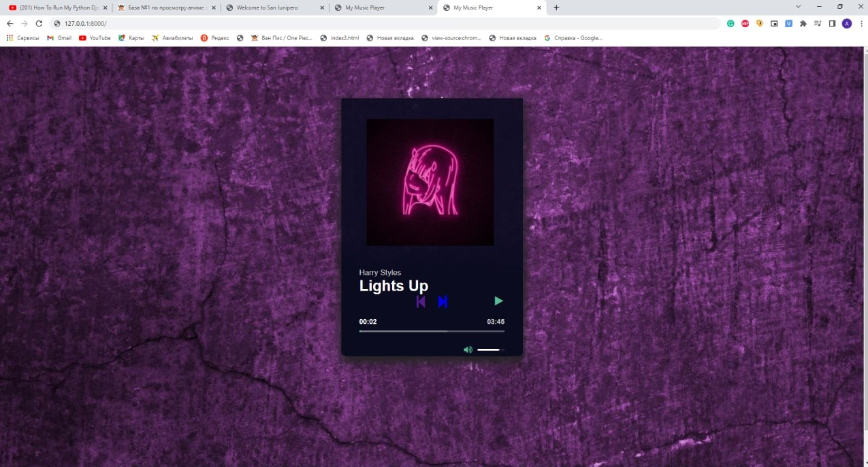
Project Design/Architecture

Slide 4
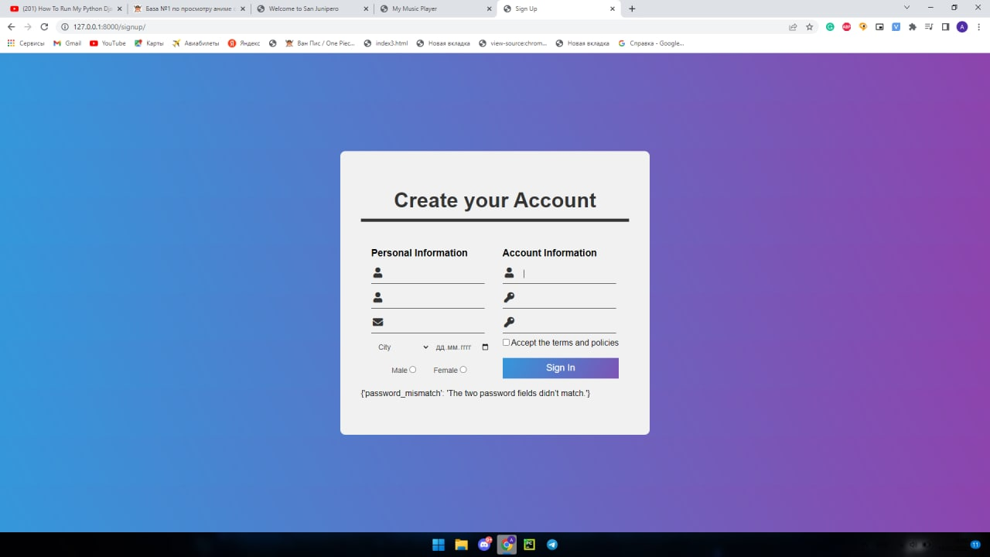
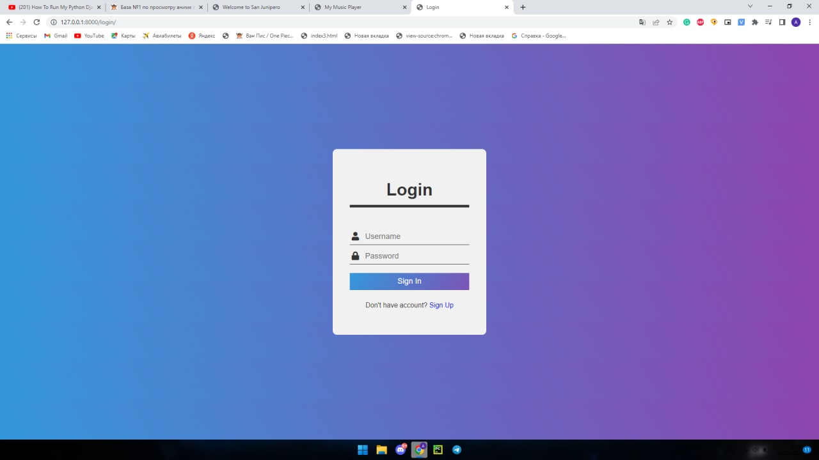
THE REGISTRATION PAGE

Slide 5
History
First of all we made an approximate design of our project
Then we create playlist and add songs to playlists
After that we moved to registration page, logic and albums biography of artist

Slide 6
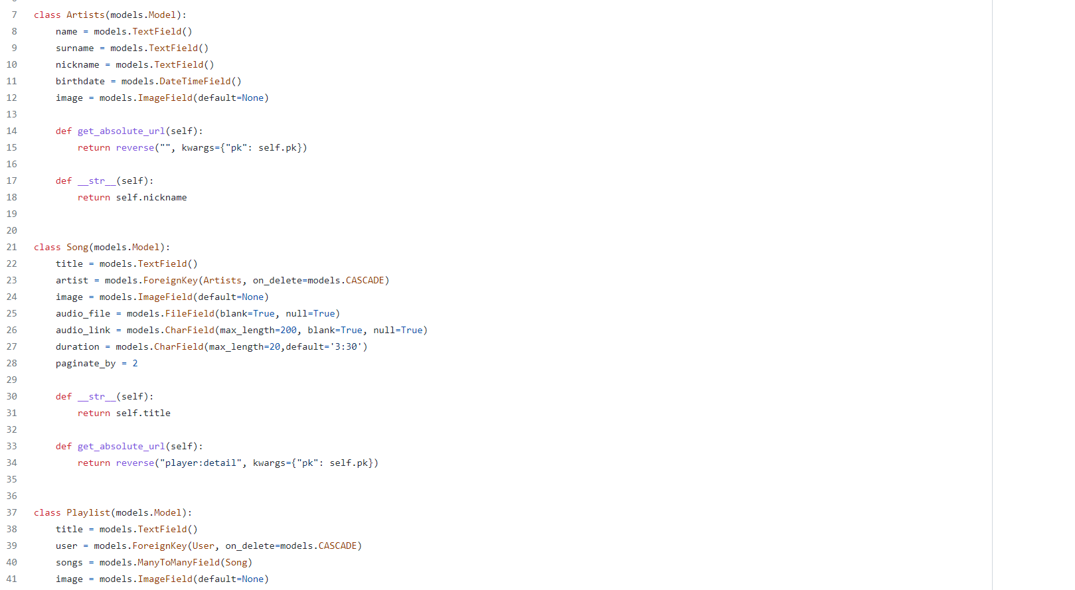
Diagram of Models

Slide 7

Future Works
I think that this is the beginning of our project and there are even more inspiring projects ahead of us.
As for this project(SanJunipero), we can create an application of this site and take this idea for our next project
And I want to add a function to download a full playlist or one music

Slide 8
AND IT’S ALL
THANKS YOU FOR YOUR ATTENTION

